Slide 1
AZURE PROJECT
SUBMITTED BY,
DIVYA SANJAYAN
214361@ust-global.com

Slide 2
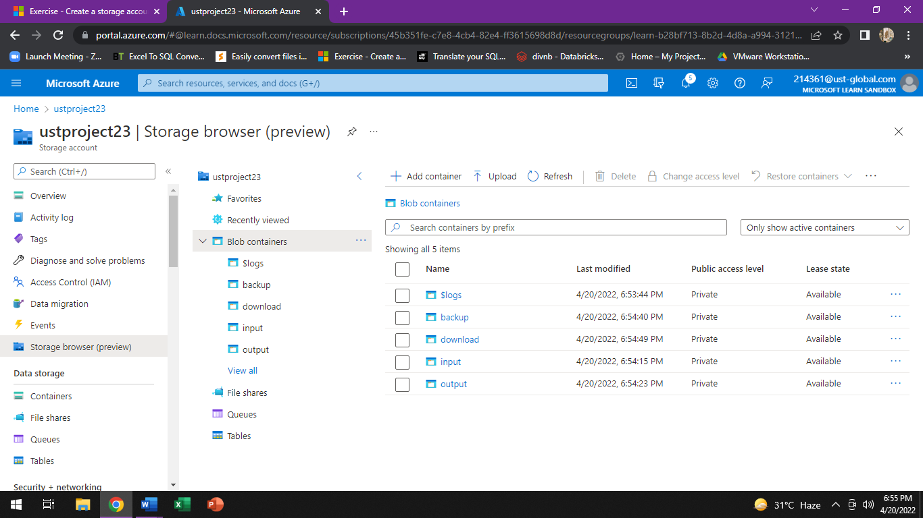
STORAGE ACCOUNT IN AZRE WITH 4 CONTAINERS(INPUT,OUTPUT,DOWNLOAD,BACKUP)

Slide 3
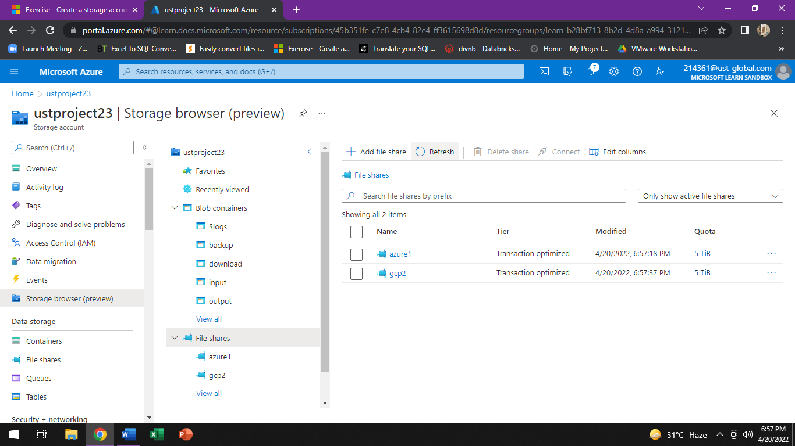
FILE SHARE WITH 2 DIRECTORIES(PROJECT AZURE1,PROJECT GCP2)

Slide 4
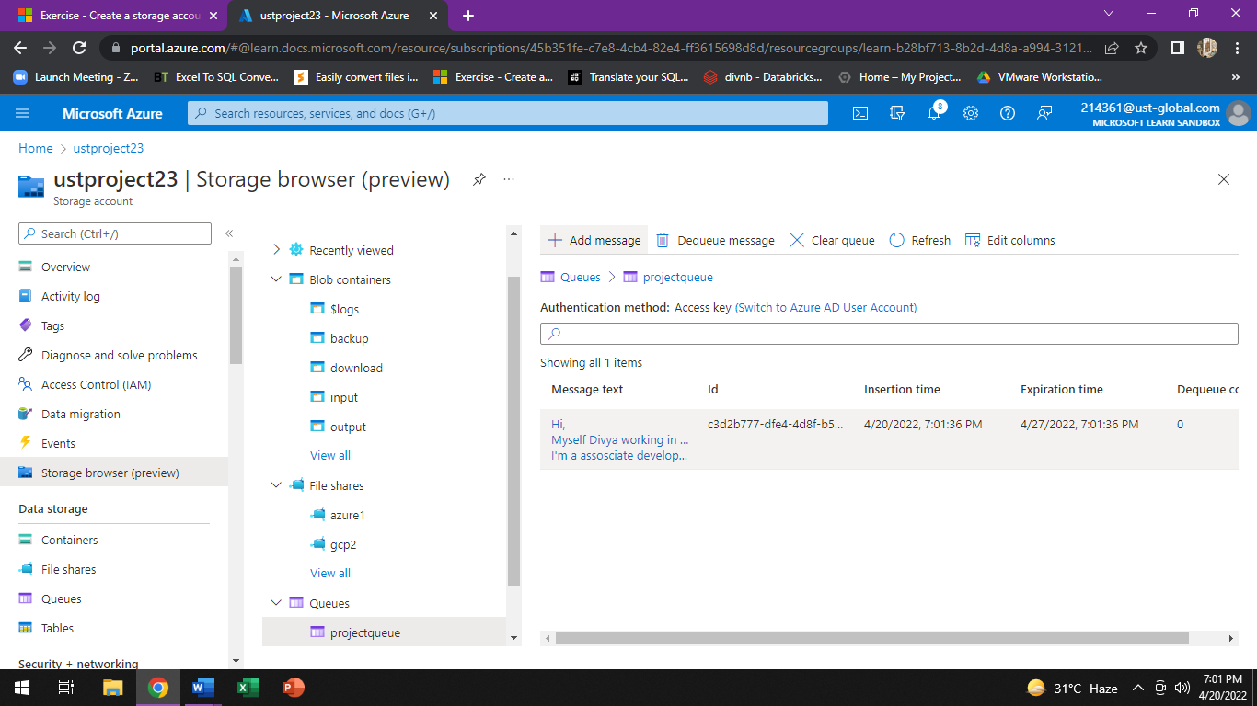
MESSAGE QUEUE WITH A MESSAGE

Slide 5
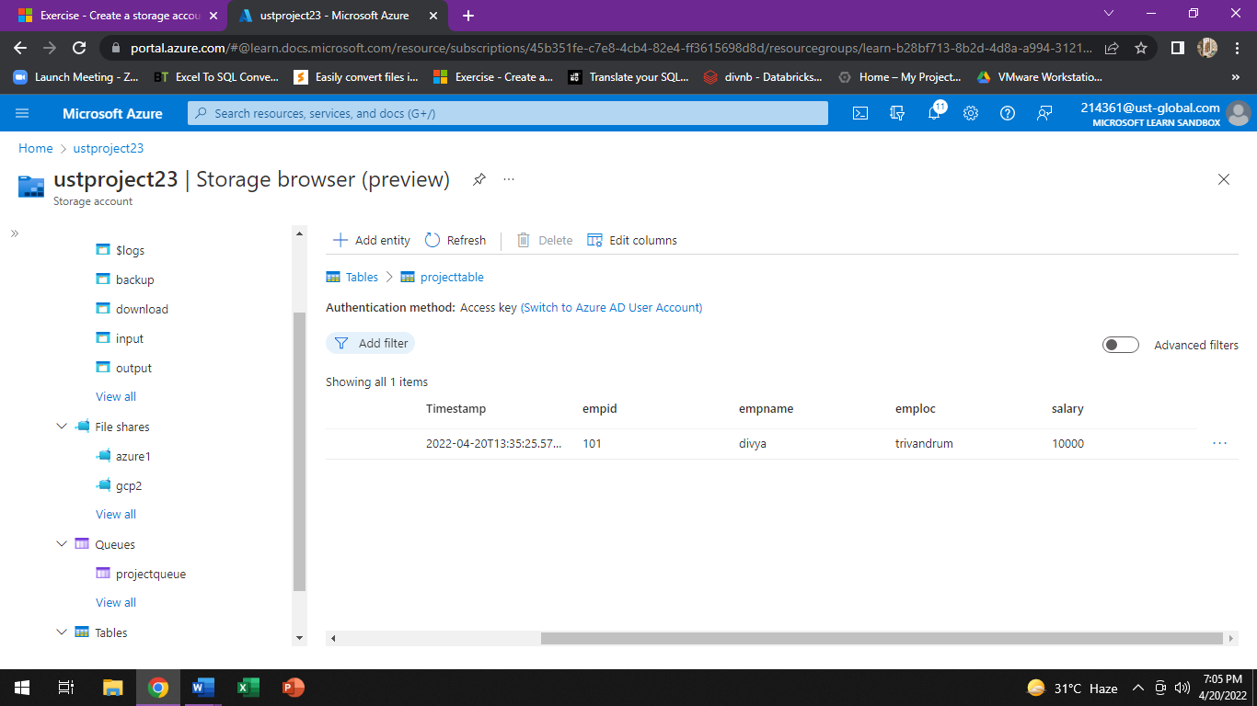
TABLE

Slide 6
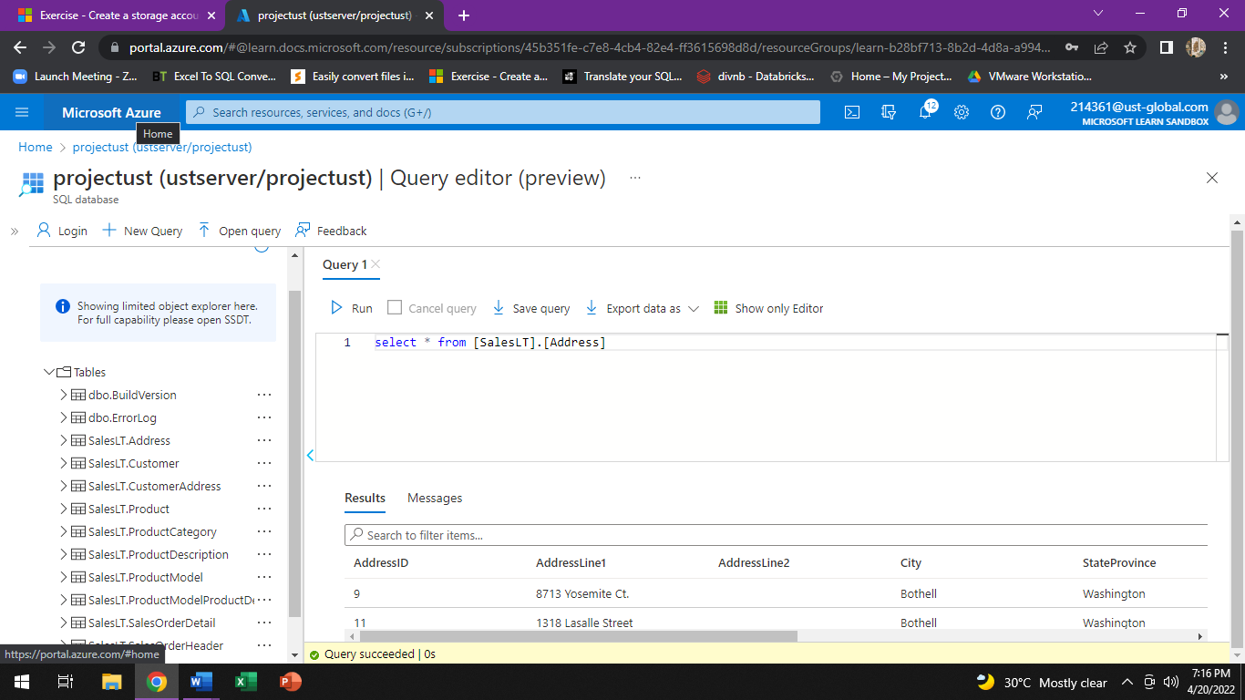
SAMPLE DATABASE WITH QUERY

Slide 7
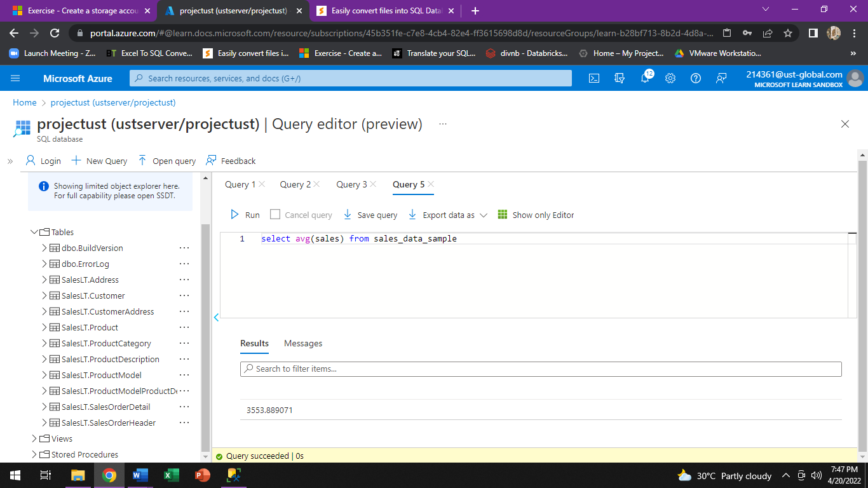
TO ESTIMATE THE UNIT SALES OF RETAIL GOODS

Slide 8
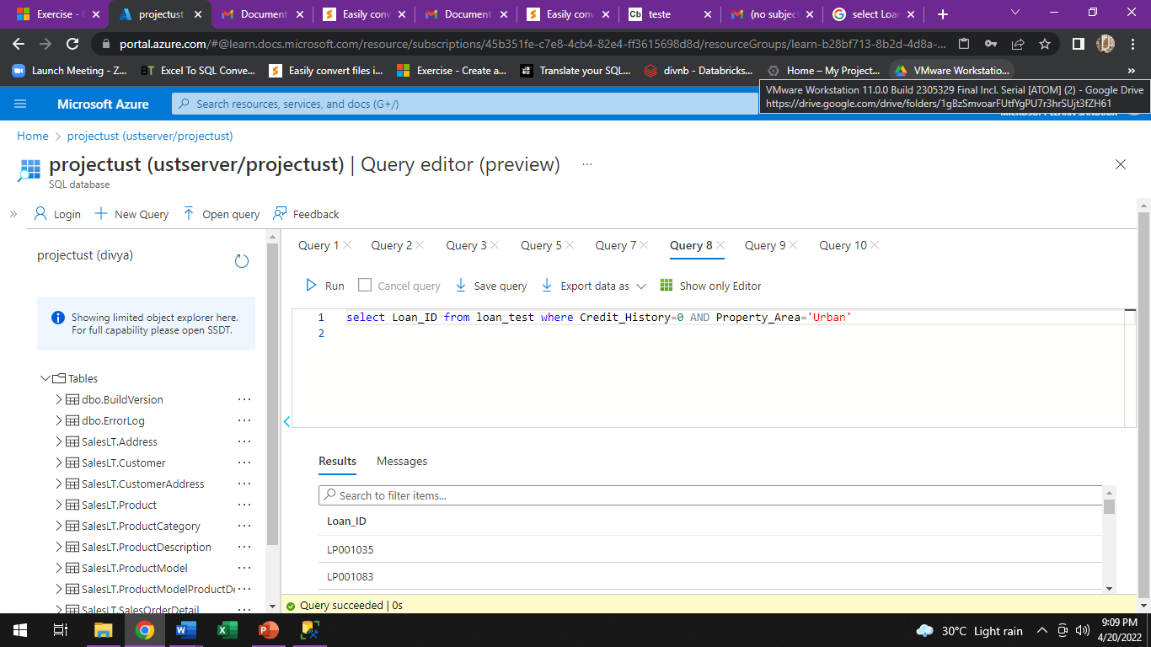
FINANCIAL NEED PROGRAMS FOR CONSUMER LOAN PRODUCTS

Slide 9
THANK YOU.

